Slide 1

Team Name : Curi_Mind
Team Leader Name : Arunima Paunikar
Problem Statement : Complex legal documents cause confusion and high costs; users need clear, easier and actionable guidance.

Slide 2

Brief about the prototype:
Upload & Summarize: Get plain-English summaries instantly.
Verify & Categorize: Check document authenticity, type, and parties involved.
Clause Analysis: Clause-by-clause explanations with risk levels and recommended actions.
Interactive Q&A: Ask questions to get detailed insights about the document.

Slide 3
Opportunity
How different is it from any of the other existing solutions?
Other existing solutions are costly, complex, no explainability, whereas EasyJuris is simple, affordable, explains in plain English (in future, multilingual).
How will it be able to solve the problem?
Upload & Analyze: AI scans contracts and flags risky clauses instantly.
Plain-English Explanations: Understand each clause with actionable next steps.
Reduce Costs & Confusion: Empowers SMEs, startups, and individuals to make safer, faster decisions.
Virtual Legal Assistant: 24/7 support without expensive consultants.

Slide 4
Opportunity
USP of the proposed solution
AI Clause Explainability: Simplifies legal jargon with risk insights.
Actionable Guidance: Recommends next steps, not just flags risks.
Privacy & Authenticity: Secure uploads with document verification.
Interactive Insights: Q&A, voice explanations, and checklists.
Smart Document Management: Categorization, timelines, and search.
Lightweight & Scalable: MERN + GenAI platform, affordable for all.
Domain & Multilingual: Supports NDAs, SaaS, employment contracts in multiple languages.

Slide 5
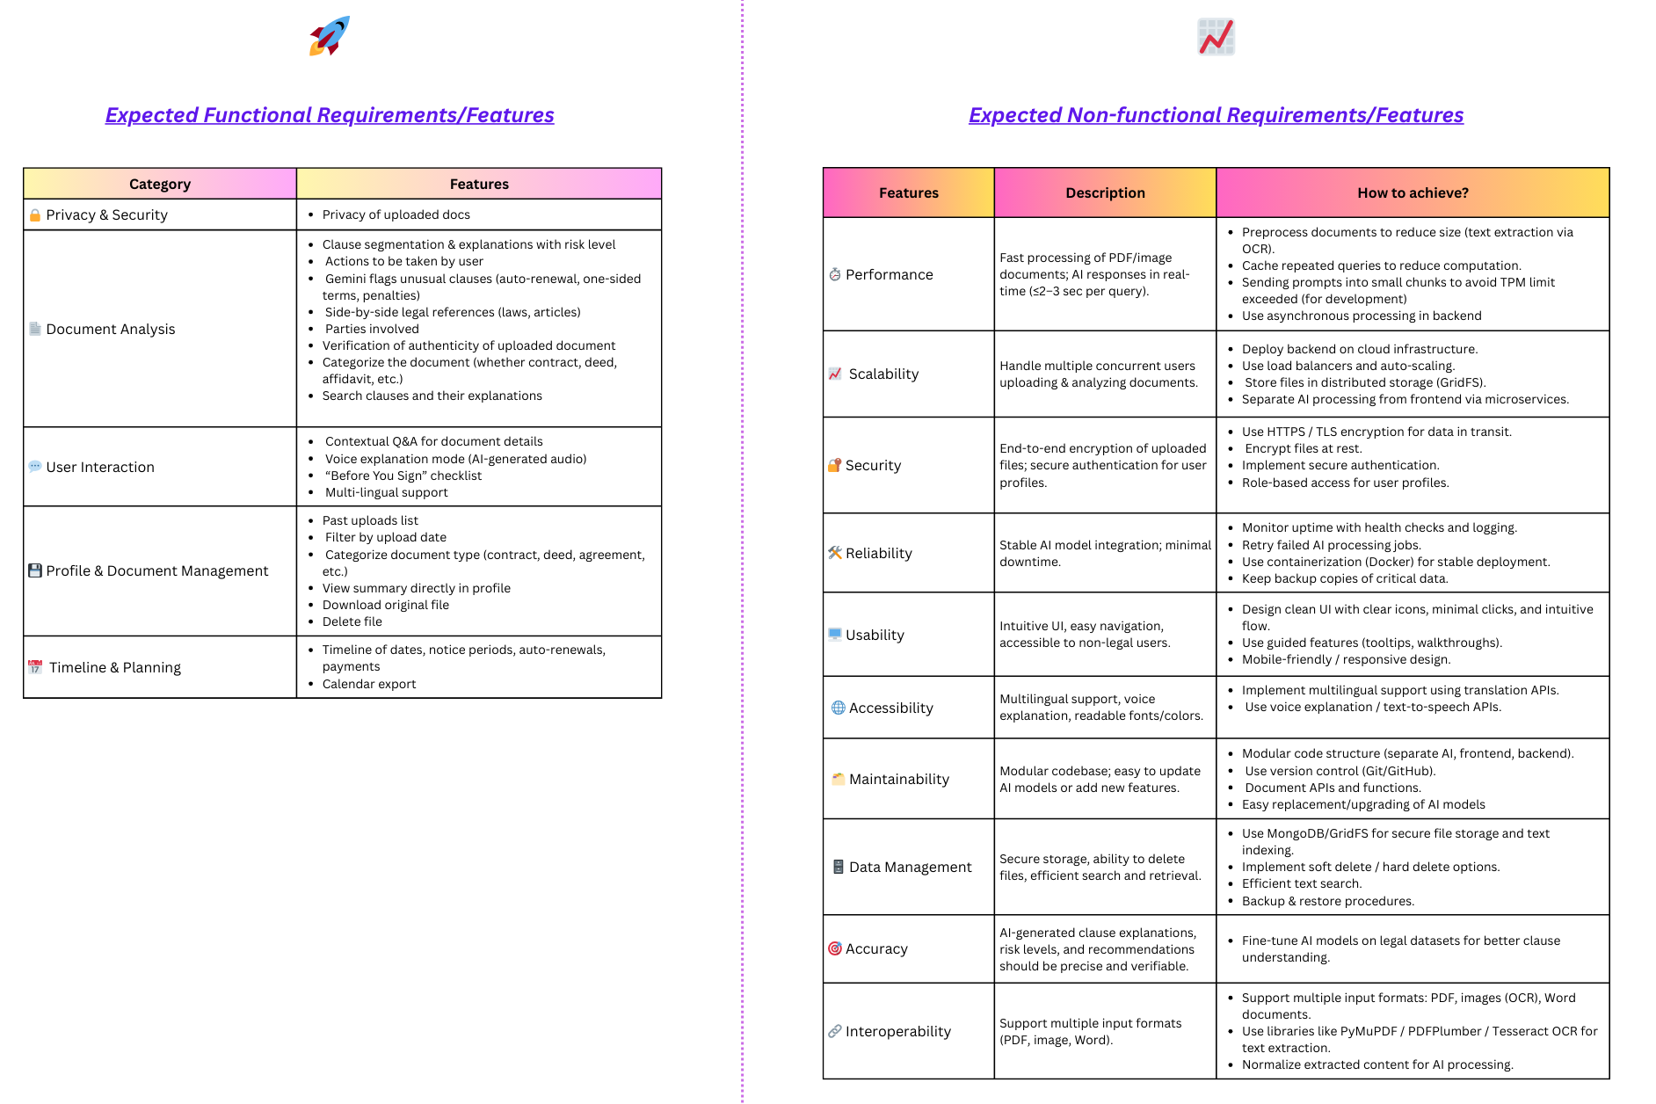
List of features offered by the solution:
Link: https://www.canva.com/design/DAGw-s8Zk38/vOLhkEZHPZv-Bd0nKym38g/edit?utm_content=DAGw-s8Zk38&utm_campaign=designshare&utm_medium=link2&utm_source=sharebutton

Slide 6
Process flow diagram
Link: https://www.canva.com/design/DAGw_IxioUY/OxITvf-czK_GcLfTWWFqfQ/edit?utm_content=DAGw_IxioUY&utm_campaign=designshare&utm_medium=link2&utm_source=sharebutton

Slide 7
Wireframe diagram of the proposed solution
Link: https://www.canva.com/design/DAGw_y6CQ3Y/e6xpxmigGK4mfqAXsjt29w/edit?utm_content=DAGw_y6CQ3Y&utm_campaign=designshare&utm_medium=link2&utm_source=sharebutton

Slide 8
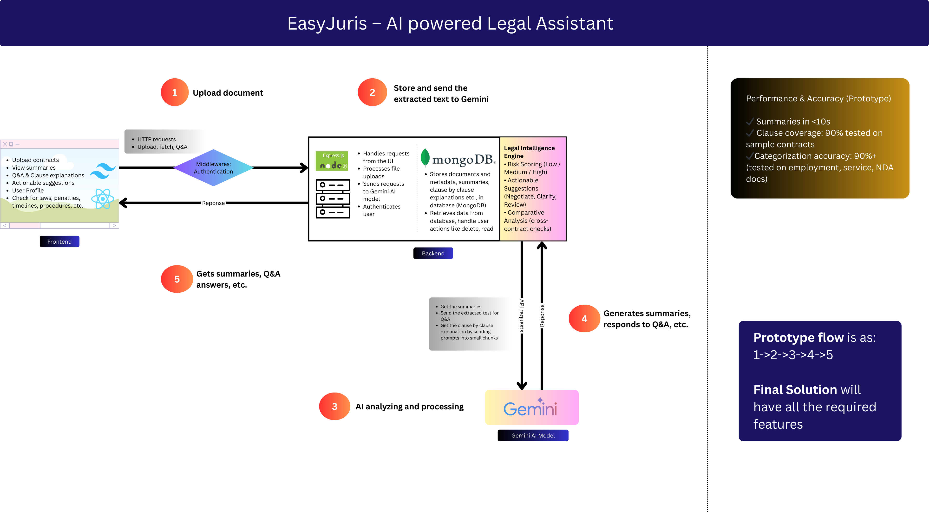
Architecture diagram of the proposed solution
Link: https://www.canva.com/design/DAGxCU27_VE/EwzbtPl1lwV06ML5RPAz6A/edit?utm_content=DAGxCU27_VE&utm_campaign=designshare&utm_medium=link2&utm_source=sharebutton

Slide 9
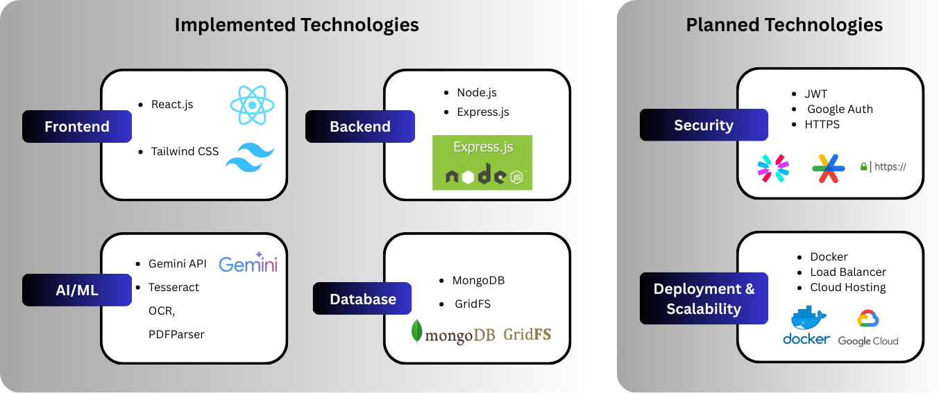
Technologies to be used in the solution:
*
*More technologies as per expected features’ implementation

Slide 10
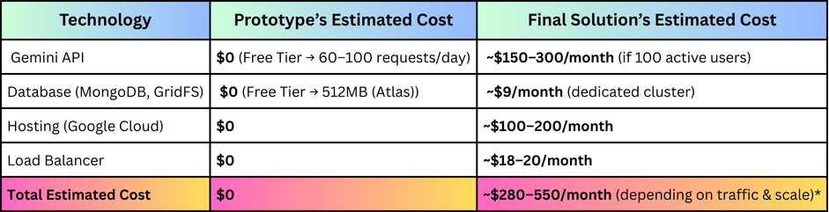
Estimated implementation cost:
*Estimated cost may increase as expected features get implemented in the final solution

Slide 11


